Slide 1
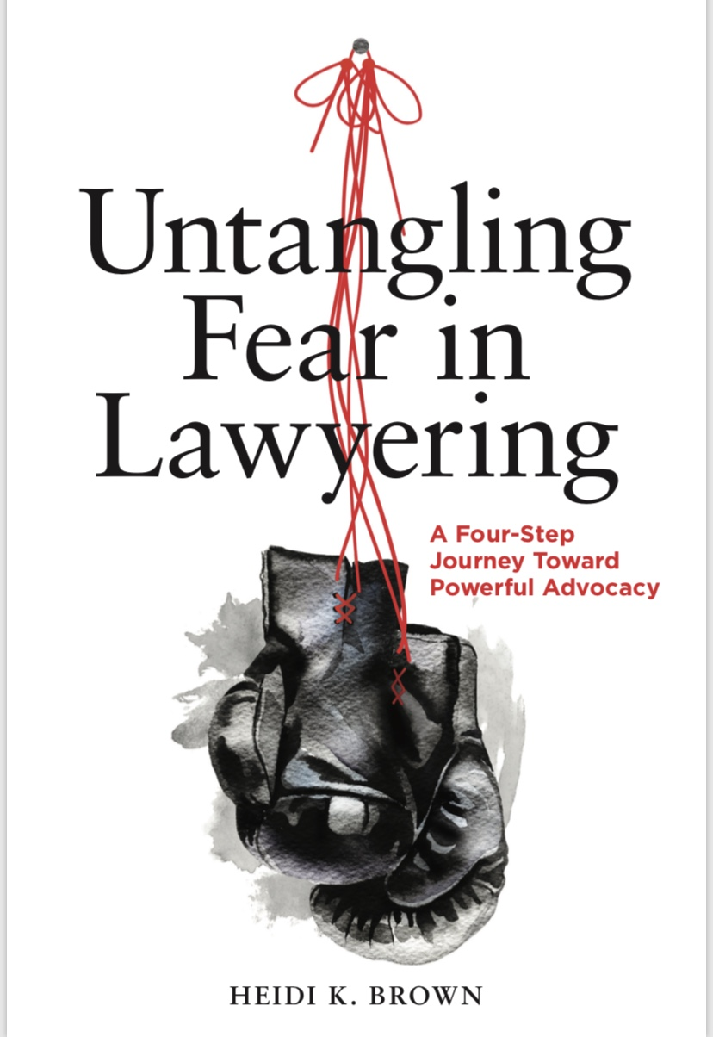
Heidi K. Brown
H

Slide 3
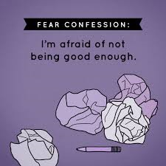
Fears Our Students Experience
Speaking in Class
Oral Arguments
Failure
Criticism/Judgment
Mistake-Making
Not Being “Cut Out” for the Law
Others?

Slide 4
Messages We Hear About Fear
Just Do It!
Fake It Till You Make It!
Get Over It!
Face Your Fears!
Do Something Every Day That
Scares You!
If Your Dreams Don’t Scare You, They’re Not Big Enough!
If You’re Not Afraid, It’s Time to “Leave the Law”!

Slide 5
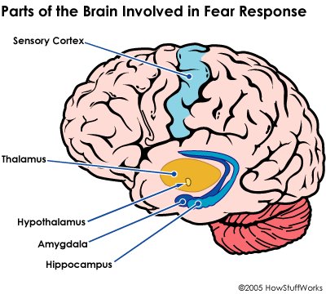
The Science of Fear
Fear blocks learning and performance…
So, messages like “just do it” don’t help.

Slide 6
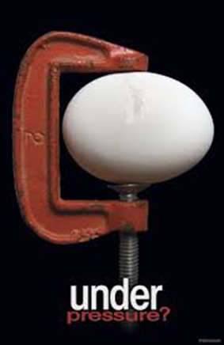
Impact on Well-Being
Entering law students:
Psychological profile similar to that
of the general public
Graduating law students:
20-40% indicate a “psychological
dysfunction”
Source: www.daveneefoundation.org

Slide 7
The Reality of Fear in Law School
The National Task Force on Lawyer Well-Being reported factors that “hinder seeking help for mental health conditions”:
“fear of jeopardizing academic standing or admission to the practice of law, social stigma, and privacy concerns”
“fear of adverse reactions by others whose opinions are important”
“fear of career repercussions”

Slide 8
Our Profession Has a FEAR Problem
“You live in constant fear that the client or rainmaking partner who’s giving you work might cut you off any moment. . . . The cult of perfectionism is indeed pervasive in law firms—the notion that you should feel deep shame about an inconsequential typo or experience terror for not properly reading the unstated wishes of some client or senior partner.”
Vivia Chen, The American Lawyer
(in response to the death of a Sidley partner)

Slide 9
Solutions?
Instead of downplaying, minimizing, ignoring, or shrugging off fear, OR lauding it as the world’s greatest motivator…
LET’S HELP STUDENTS UNTANGLE IT

Slide 10
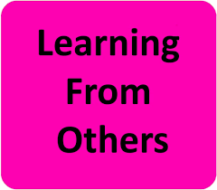
What are Other Professions Doing?
Medicine
Journalism
Engineering
Business/Entrepreneurship

Slide 11
Medicine, Fear, and Mistake-Making
1999 Institute of Medicine report: shocking number of deaths from medical errors
2006: recognizing OUT LOUD medicine’s “hidden curriculum”
“culture of intimidation”
“culture of fear”
“misuse of the Socratic method”
“myth of infallibility” of the “good doctor”
Not just in America!
A 2015 survey of medical students at the University of Sydney and the University of Melbourne reported that “teaching by humiliation,” including a misuse of the Socratic method, has been “part of the culture in medicine.”

Slide 12
Medicine, Fear, and Mistake-Making
Solutions?
Medical schools have begun developing formal coursework on:
identifying, preventing, and remedying medical errors
communicating about fear and mistake-making
how to have difficult conversations about fear and mistakes (with superiors and patients)
metacognition
Simulations
Virtual reality technology

Slide 13
Journalism, Fear, and Mistake-Making
Professor Lisa Taylor (Ryerson University):
“The proliferation of new technologies, the intellectual demands of explaining complex subject matter, the fear of getting the story wrong or missing a deadline” can contribute to the development of “a very damaged human being.”
Journalists (and lawyers!) often ignore “well-being”
Courses integrating mindfulness
Thriving for Action program: exploring mistake-making and resilience
Columbia: Dart Center for Journalism & Trauma

Slide 14
Engineering, Fear, and Mistake-Making
Recognition that ignoring the inevitability of mistakes in the profession can breed fear and “imposter syndrome” in new engineers
University of Washington: a new course “with ample opportunities for students to make mistakes—a fodder for reflection—and learn from them”
Professor Henry Petroski of Duke University: “The course employs failure as a unifying concept for understanding the history and practice of engineering and design.”
Professor David Beach of Stanford University: a course specifically designed to teach engineering students how to learn from mistakes

Slide 15
Business/Entrepreneurship, Fear, and Mistake-Making
Janet Sernack (Australia-based CEO):
Cultivating a “fail fast” culture can “help organizations unfreeze, survive, flow and flourish with the current levels of FEAR, ambiguity, uncertainty, volatility and instability in 21st century organizations”
Professor Bob Sicina (American University): a course called “Learn from Failure”:
Reducing “fear of failure” through reflection
Students write about failure and mistakes

Slide 16
“Untangling Fear in Lawyering” Process
Four Steps to Fortitude:
Comparative Fearlessness
Mental Reboot
Channeling Our Inner Athlete
Cultivating a Culture of Fortitude

Slide 17
Comparative Fearlessness
Recognizing other areas in our non-lawyer personas where we feel “swagger”
Are there areas in our lives where, by society’s standards, we “should” feel fear but we don’t?
Are there areas in our lawyering lives where, by the profession’s standards, we “shouldn’t” feel fear but we do?
What is the difference?

Slide 18
Mental Reboot
Consider the REAL root of the fear
Past fear of judgment?
Past fear of failure?
Listen to and transcribe the PAST messages we are applying in the PRESENT
Recognize their irrelevance in this new context
Draft new relevant messages for our current
lawyer persona

Slide 19
Channeling Our Inner Athlete
Enhance self-awareness → BODY SCAN
Fortify our machine
Align posture (like pillars)
Balanced stance (like an athlete)
Focus on breathing
Use our appendages
Forge eye contact
Project our voices
BE THE BLUSH!

Slide 20
Cultivating a Culture of Fortitude
Debunking stereotypes/messages about fear, failure, and mistake-making in lawyering
Understanding the science of fear
Cultivating a culture of “psychological safety”
Professor Amy Edmondson: The Fearless Organization
Empowering students to open up about fears, and ask questions to avoid/prevent mistakes
Teaching students how to have conversations about mistake discovery and remediation (establishing protocols)

Slide 21
Cultivating a Culture of Fortitude
Experts in the room!
Professor Jodi Balsam: externship reflection essay prompts about fear/mistakes
Professor Marjorie Silver’s book: Transforming Justice, Lawyers, and the Practice of Law (including Prof. Susan Brooks’s chapter)
Neha Sampat, CEO, GenLead|BelongLab: Online course on imposter syndrome

Slide 22
Cultivating a Culture of Fortitude
Recognizing and addressing client fears
Recognizing trauma-related fears
Resources for Trauma-Informed Lawyering
Sarah Katz and Deeya Haldar, “The Pedagogy of Trauma-Informed Lawyering,” 22 Clinical Law Review 22 359 (Spring 2016).
Sara E. Gold, “Trauma: What Lurks Beneath the Surface,” 24 Clinical Law Review 201 (Spring 2018).

Slide 23
Other “Fear” Resources
See Proposed “Untangling Fear” Discussion Topics (handout)
http://www.abajournal.com/magazine/article/face-fear-dont-fake-it
http://www.abajournal.com/magazine/article/fear_of_lawyering/
Untangling Fear in Lawyering book: https://www.americanbar.org/products/inv/book/358687385/

Slide 24
Let’s Listen … and Empower
If I really listened to my fear, I could’ve clearly assigned value to what moved my spirit:
Writing.
Painting.
Pulling something from nothing.
Meera Lee Patel

Slide 25
Let’s Untangle Fear Together…
Professor and Author
Heidi K. Brown
Brooklyn Law School
Heidi.Brown@brooklaw.edu
www.theintrovertedlawyer.com
Twitter: @introvertlawyer
Instagram: @introvertedlawyer

